Slide 1
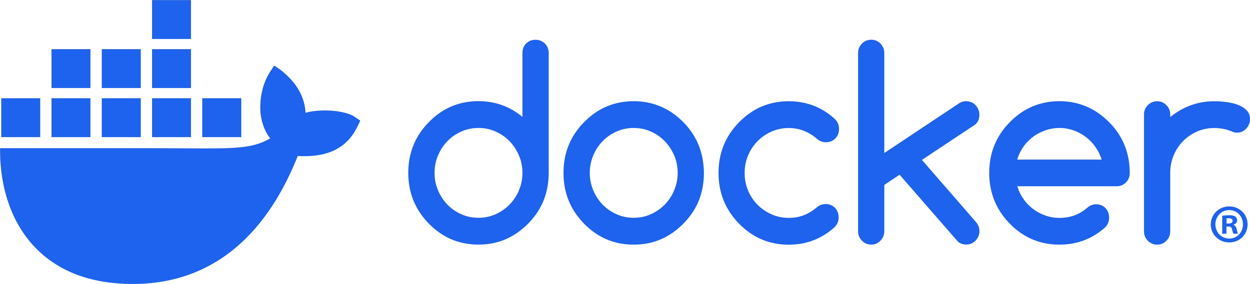

Part 4: Docker File Deeper

Slide 2
What We Will Cover
Filename Convention
Image Layers
Docker File Syntax
Base Image
Environment Setup
Comments
Installing Dependencies
Copying Files
Build Context
Ignoring Files
Environment Variables
Exposing Ports
Executing Commands
Building & Running

Slide 3
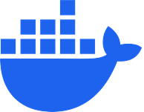
Dockerfile Syntax

Slide 4
# syntax=docker/dockerfile:1
FROM ubuntu:22.04
# install app dependencies
RUN apt-get update && apt-get install -y python3 python3-pip
RUN pip install flask==3.0.*
# install app
COPY hello.py /
# final configuration
ENV FLASK_APP=hello
EXPOSE 8000
CMD ["flask", "run", "--host", "0.0.0.0", "--port", "8000"]

Slide 5
Dockerfile Syntax
The first line to add to a Dockerfile is a # syntax parser directive.
While optional, this directive instructs the Docker builder what syntax to use when parsing the Dockerfile, and allows older Docker versions with BuildKit enabled to use a specific Dockerfile frontend before starting the build.
Parser directives must appear before any other comment, whitespace, or Dockerfile instruction in your Dockerfile, and should be the first line in Dockerfiles.
Notes:
https://docs.docker.com/build/concepts/dockerfile/#dockerfile-syntax

Slide 6
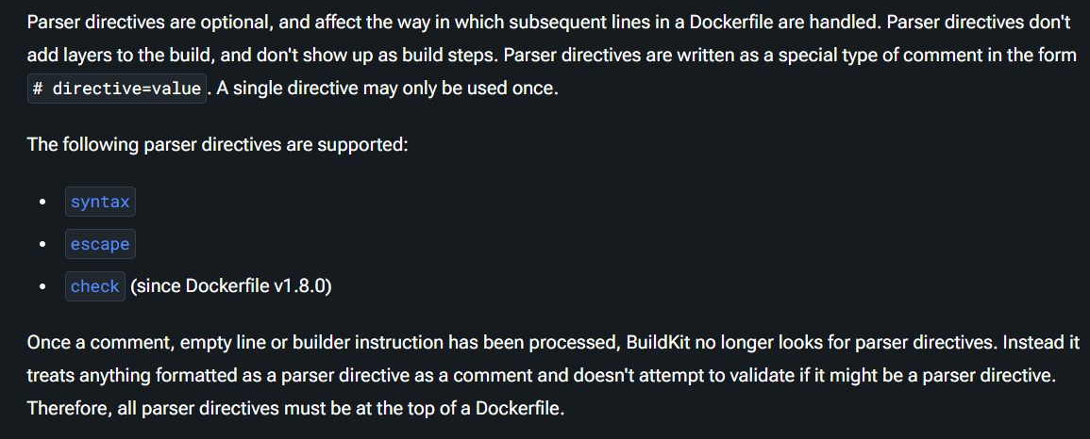
Parser Directives
Notes:
https://docs.docker.com/build/concepts/dockerfile/#dockerfile-syntax

Slide 7



Notes:
https://www.youtube.com/channel/UC35ZpwldGw7ZJ5R-2sLijzw

Slide 8
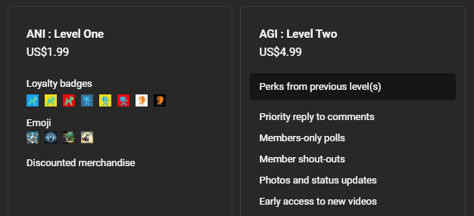

Become a Member!
Notes:
https://www.youtube.com/channel/UC35ZpwldGw7ZJ5R-2sLijzw/join

Slide 9

https://www.youtube.com/@AINewsFresh

Slide 10
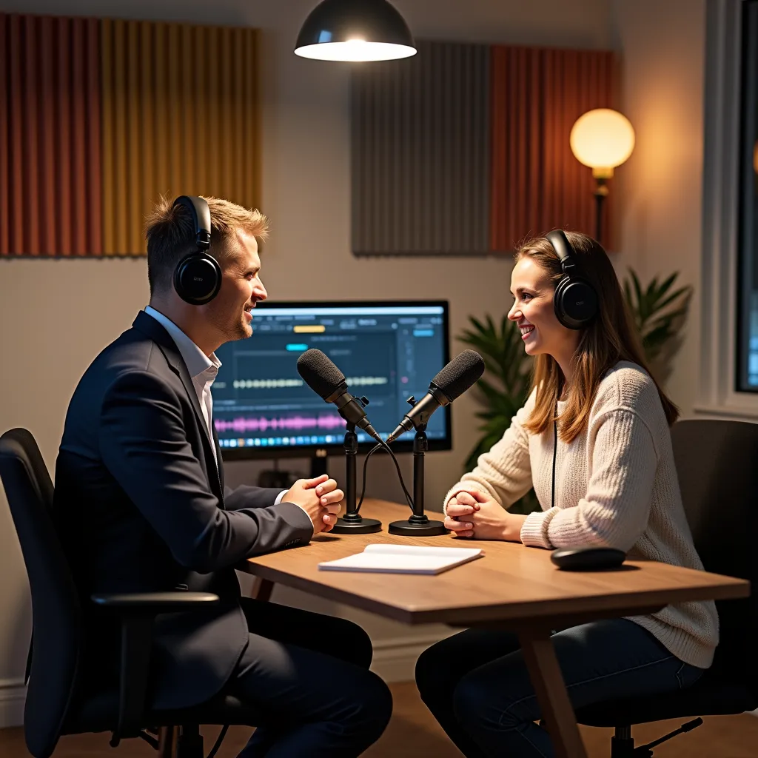

https://www.youtube.com/@DailyAINewsPodcast

Slide 11
Base Image

Slide 12
# syntax=docker/dockerfile:1
FROM ubuntu:22.04
# install app dependencies
RUN apt-get update && apt-get install -y python3 python3-pip
RUN pip install flask==3.0.*
# install app
COPY hello.py /
# final configuration
ENV FLASK_APP=hello
EXPOSE 8000
CMD ["flask", "run", "--host", "0.0.0.0", "--port", "8000"]

Slide 13
Base Image
The FROM instruction sets your base image.
All instructions that follow are executed in this base image.
Images, follow the name:tag standard for naming Docker images. When you build images, you use this notation to name your images.
There are many public images you can leverage in your projects, by importing them into your build steps using the Dockerfile FROM instruction.
Docker Hub contains a large set of official images that you can use for this purpose.
Notes:
https://docs.docker.com/build/concepts/dockerfile/#base-image

Slide 14
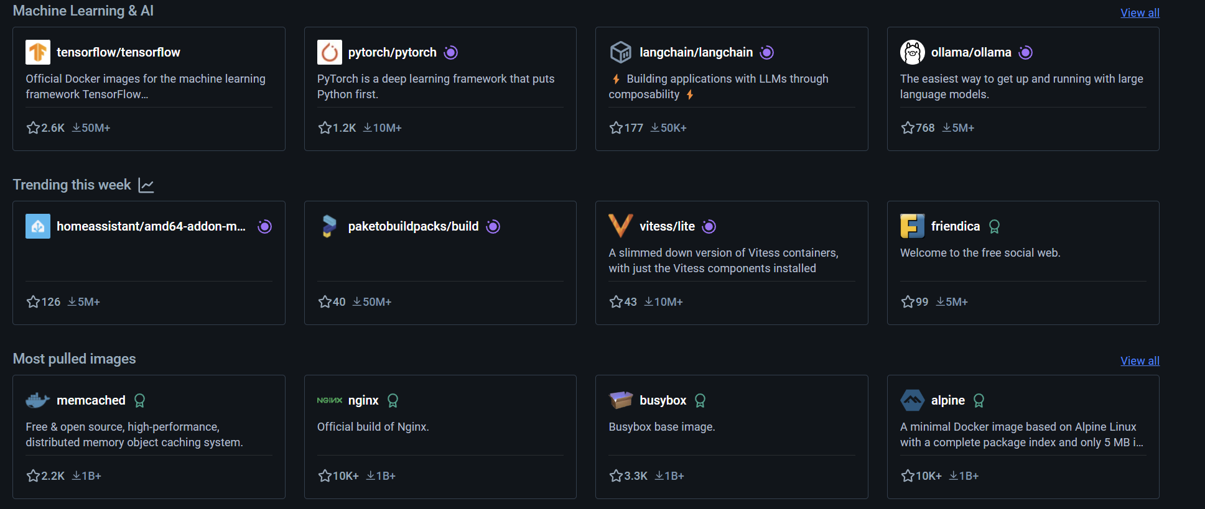
Demo: Docker Hub Images
Notes:
https://hub.docker.com/

Slide 15
Comments

Slide 16
# syntax=docker/dockerfile:1
FROM ubuntu:22.04
# install app dependencies
RUN apt-get update && apt-get install -y python3 python3-pip
RUN pip install flask==3.0.*
# install app
COPY hello.py /
# final configuration
ENV FLASK_APP=hello
EXPOSE 8000
CMD ["flask", "run", "--host", "0.0.0.0", "--port", "8000"]

Slide 17
Comments
Comments in Dockerfiles begin with the # symbol.
As your Dockerfile evolves, comments can be instrumental to document how your Dockerfile works.
You might've noticed that comments are denoted using the same symbol as the syntax directive on the first line of the file. The symbol is only interpreted as a directive if the pattern matches a directive and appears at the beginning of the Dockerfile. Otherwise, it's treated as a comment.
Notes:
https://docs.docker.com/build/concepts/dockerfile/#base-image

Slide 18
Environment Setup

Slide 19
# syntax=docker/dockerfile:1
FROM ubuntu:22.04
# install app dependencies
RUN apt-get update && apt-get install -y python3 python3-pip
RUN pip install flask==3.0.*
# install app
COPY hello.py /
# final configuration
ENV FLASK_APP=hello
EXPOSE 8000
CMD ["flask", "run", "--host", "0.0.0.0", "--port", "8000"]

Slide 20
Environment Setup
The following lines executes commands inside the base image to set up our environment:
# install app dependencies
RUN apt-get update && apt-get install -y python3 python3-pip
RUN pip install flask==3.0.*
These lines update the system's package list, installs Python 3 and `pip`, and then installs Flask version 3.0.x using `pip`.
Notes:
https://docs.docker.com/build/concepts/dockerfile/#base-image

Slide 21
Copying Files

Slide 22
# syntax=docker/dockerfile:1
FROM ubuntu:22.04
# install app dependencies
RUN apt-get update && apt-get install -y python3 python3-pip
RUN pip install flask==3.0.*
# install app
COPY hello.py /
# final configuration
ENV FLASK_APP=hello
EXPOSE 8000
CMD ["flask", "run", "--host", "0.0.0.0", "--port", "8000"]

Slide 23
Copying Files
The next instruction uses the COPY instruction to copy the hello.py file from the current directory (build context) on the host into the root directory of our image.
After the COPY instruction, the hello.py file is added to the filesystem of the build container.
Notes:
https://docs.docker.com/build/concepts/dockerfile/#copying-files

Slide 24
Build Context

Slide 25
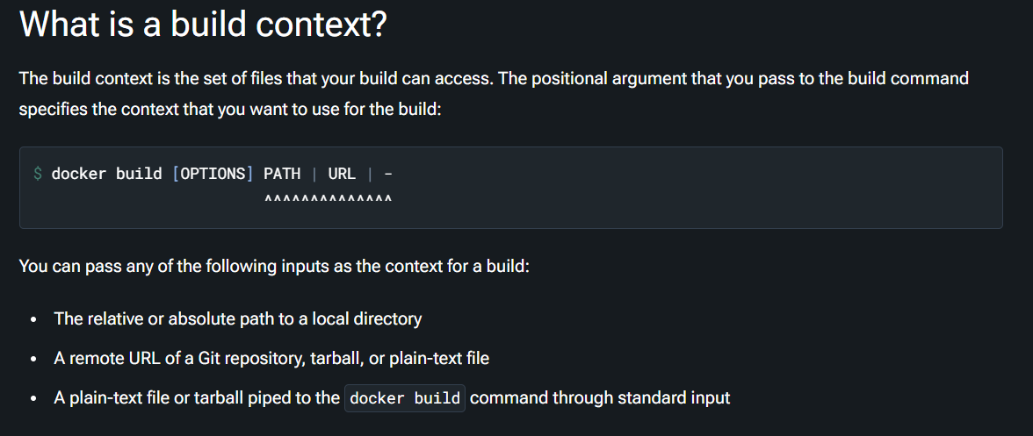
Notes:
https://docs.docker.com/build/concepts/context/

Slide 26
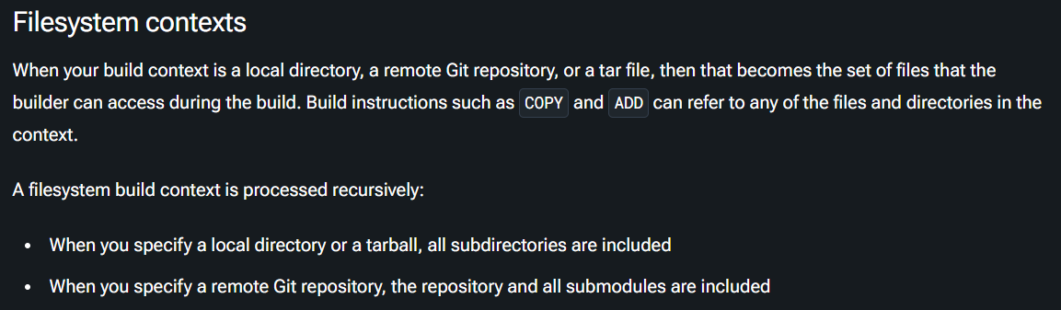
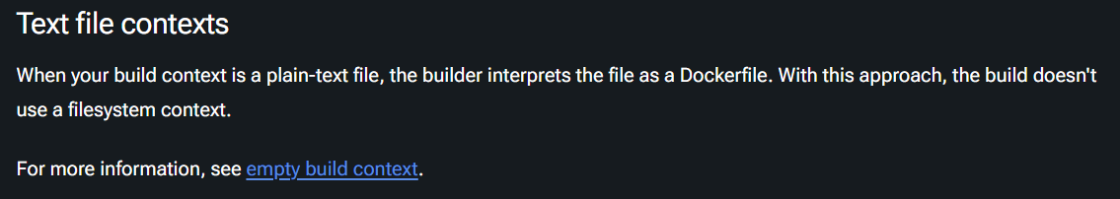
Notes:
https://docs.docker.com/build/concepts/context/#filesystem-contexts
https://docs.docker.com/build/concepts/context/#empty-context

Slide 27
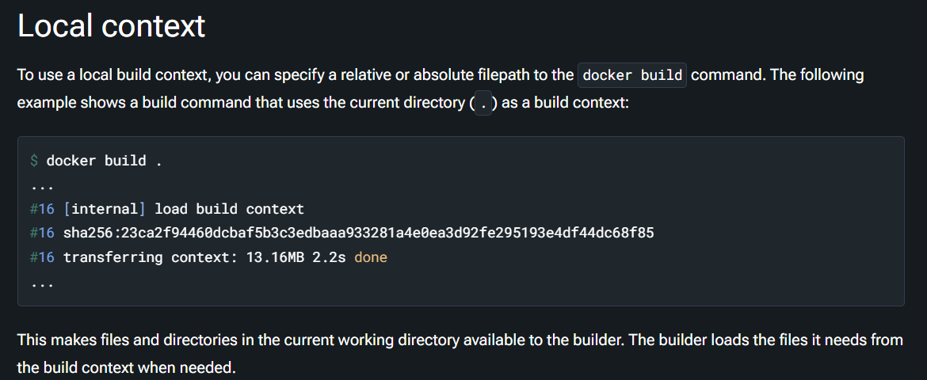
Notes:
https://docs.docker.com/build/concepts/context/#local-context

Slide 28
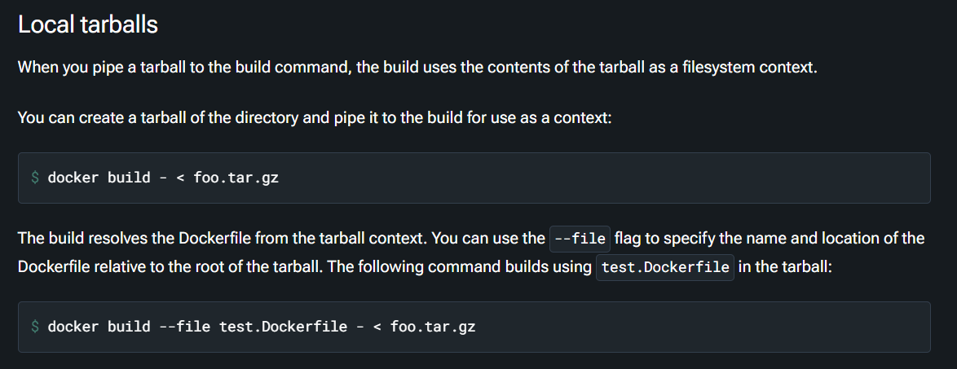
Notes:
https://docs.docker.com/build/concepts/context/#local-tarballs

Slide 29
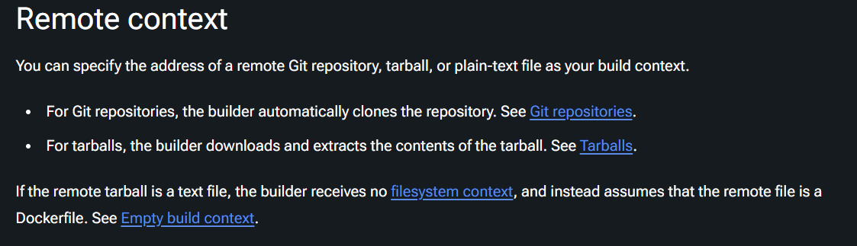
Notes:
https://docs.docker.com/build/concepts/context/#remote-context

Slide 30
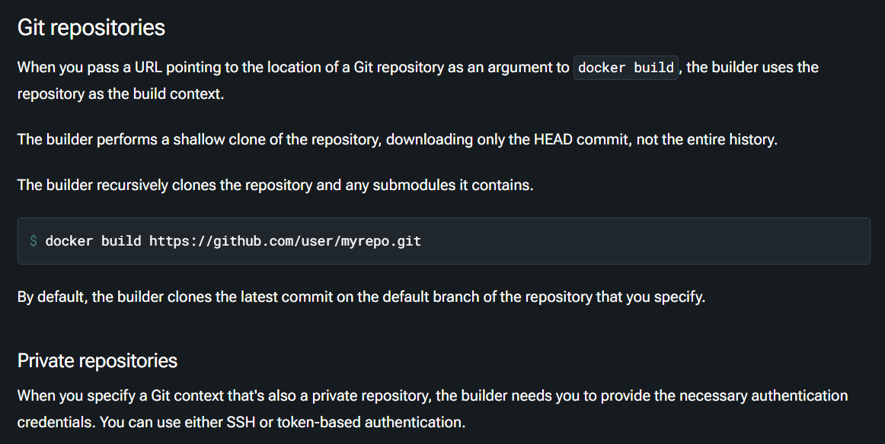

Slide 31
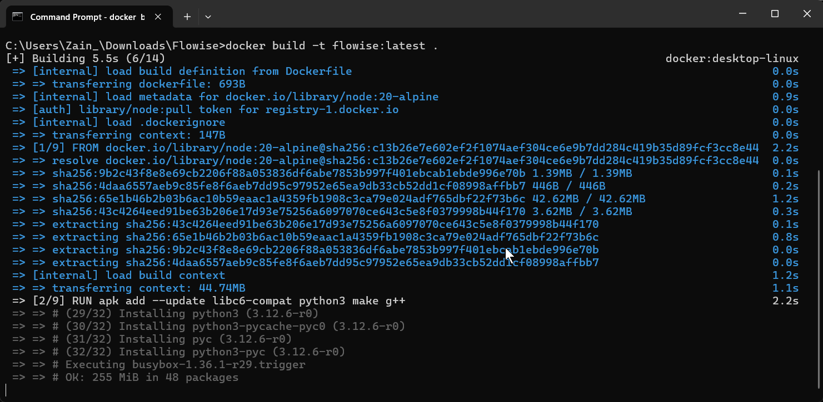
Demo: GitHub Repo Build Context
# Run image
# docker run -d -p 3000:3000 flowise
FROM node:20-alpine
RUN apk add --update libc6-compat python3 make g++
# needed for pdfjs-dist
RUN apk add --no-cache build-base cairo-dev pango-dev
# Install Chromium
RUN apk add --no-cache chromium
#install PNPM globaly
RUN npm install -g pnpm
ENV PUPPETEER_SKIP_DOWNLOAD=true
ENV PUPPETEER_EXECUTABLE_PATH=/usr/bin/chromium-browser
ENV NODE_OPTIONS=--max-old-space-size=8192
WORKDIR /usr/src
# Copy app source
COPY . .
RUN pnpm install
RUN pnpm build
EXPOSE 3000
CMD [ "pnpm", "start" ]
Notes:
https://github.com/FlowiseAI/Flowise
docker build -t flowise:latest https://github.com/FlowiseAI/Flowise.git
docker run -it -p 3000:3000 --name flowise flowise:latest

Slide 32
Ignoring Files

Slide 33
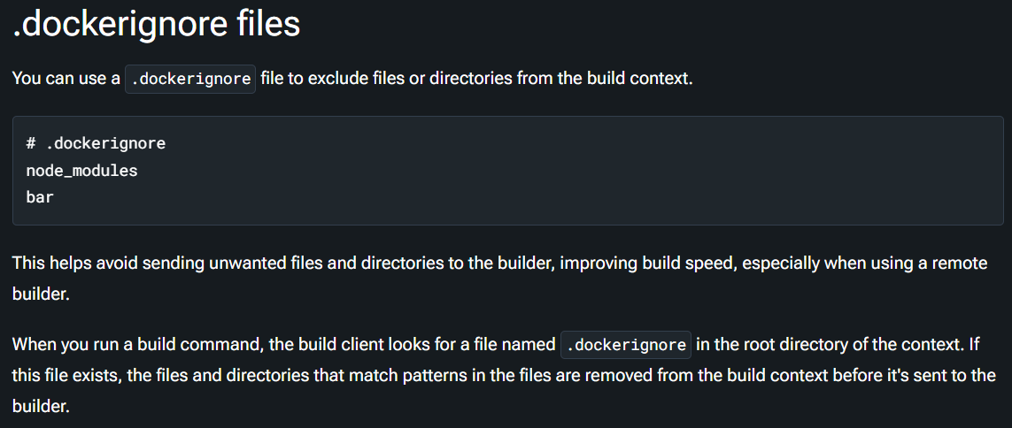
Notes:
https://docs.docker.com/build/concepts/context/#dockerignore-files

Slide 34
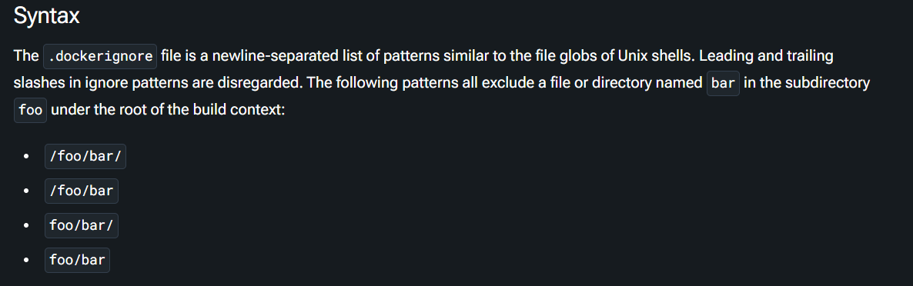
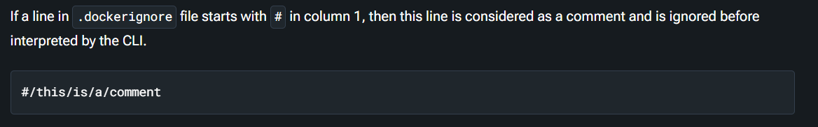
Notes:
https://docs.docker.com/build/concepts/context/#syntax

Slide 35
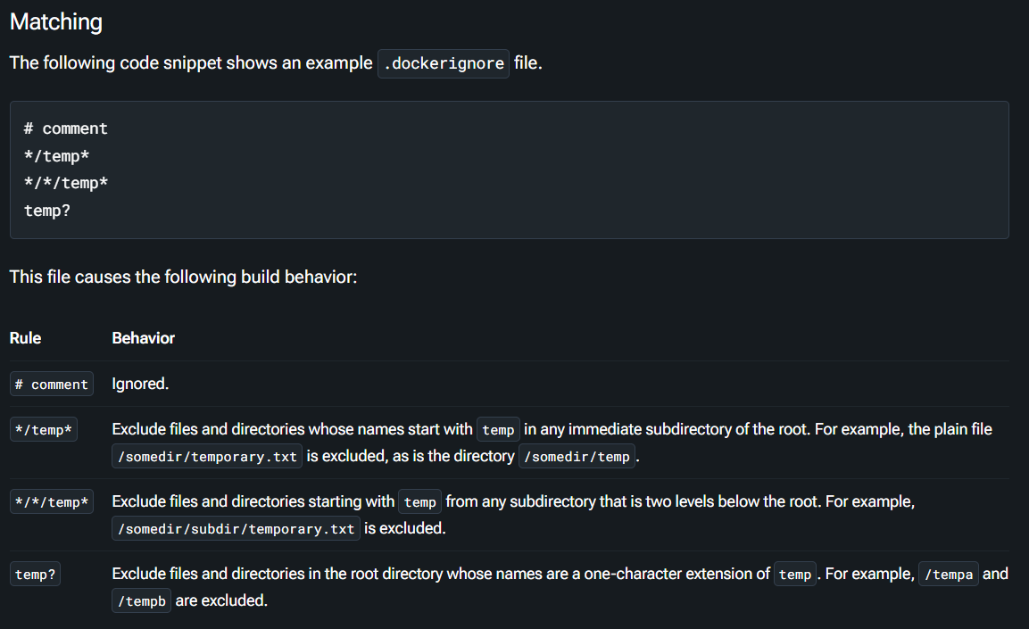
Notes:
https://docs.docker.com/build/concepts/context/#matching

Slide 36
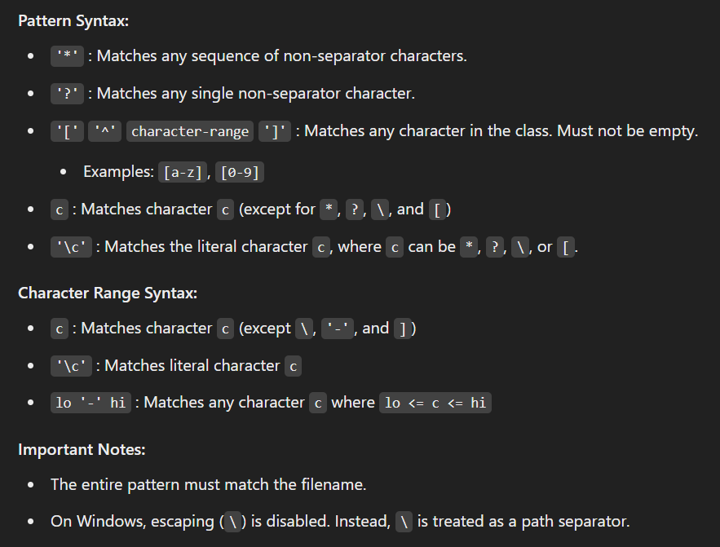
Notes:
https://pkg.go.dev/path/filepath#Match

Slide 37
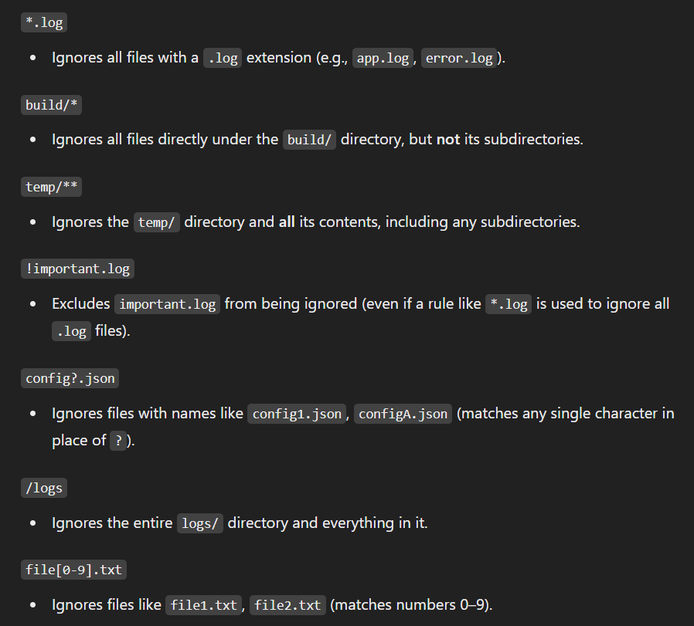
Notes:
https://pkg.go.dev/path/filepath#Match

Slide 38
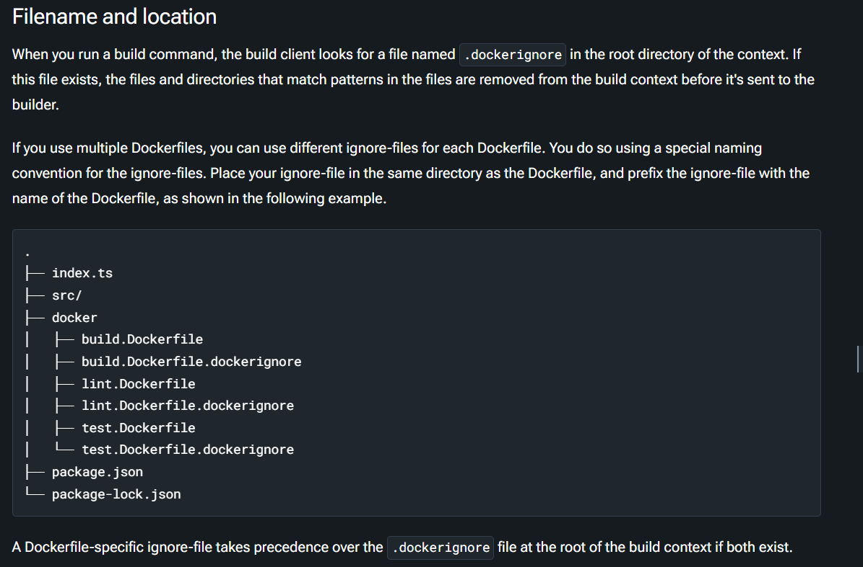
Notes:
https://docs.docker.com/build/concepts/context/#filename-and-location

Slide 39
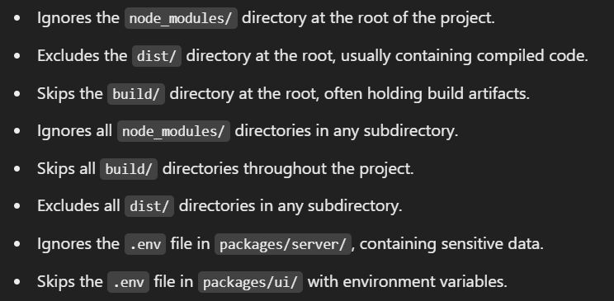
Demo: Ignoring Files
node_modules
dist
build
**/node_modules
**/build
**/dist
packages/server/.env
packages/ui/.env
Notes:
https://github.com/FlowiseAI/Flowise/blob/main/.dockerignore

Slide 40


